Slide 1



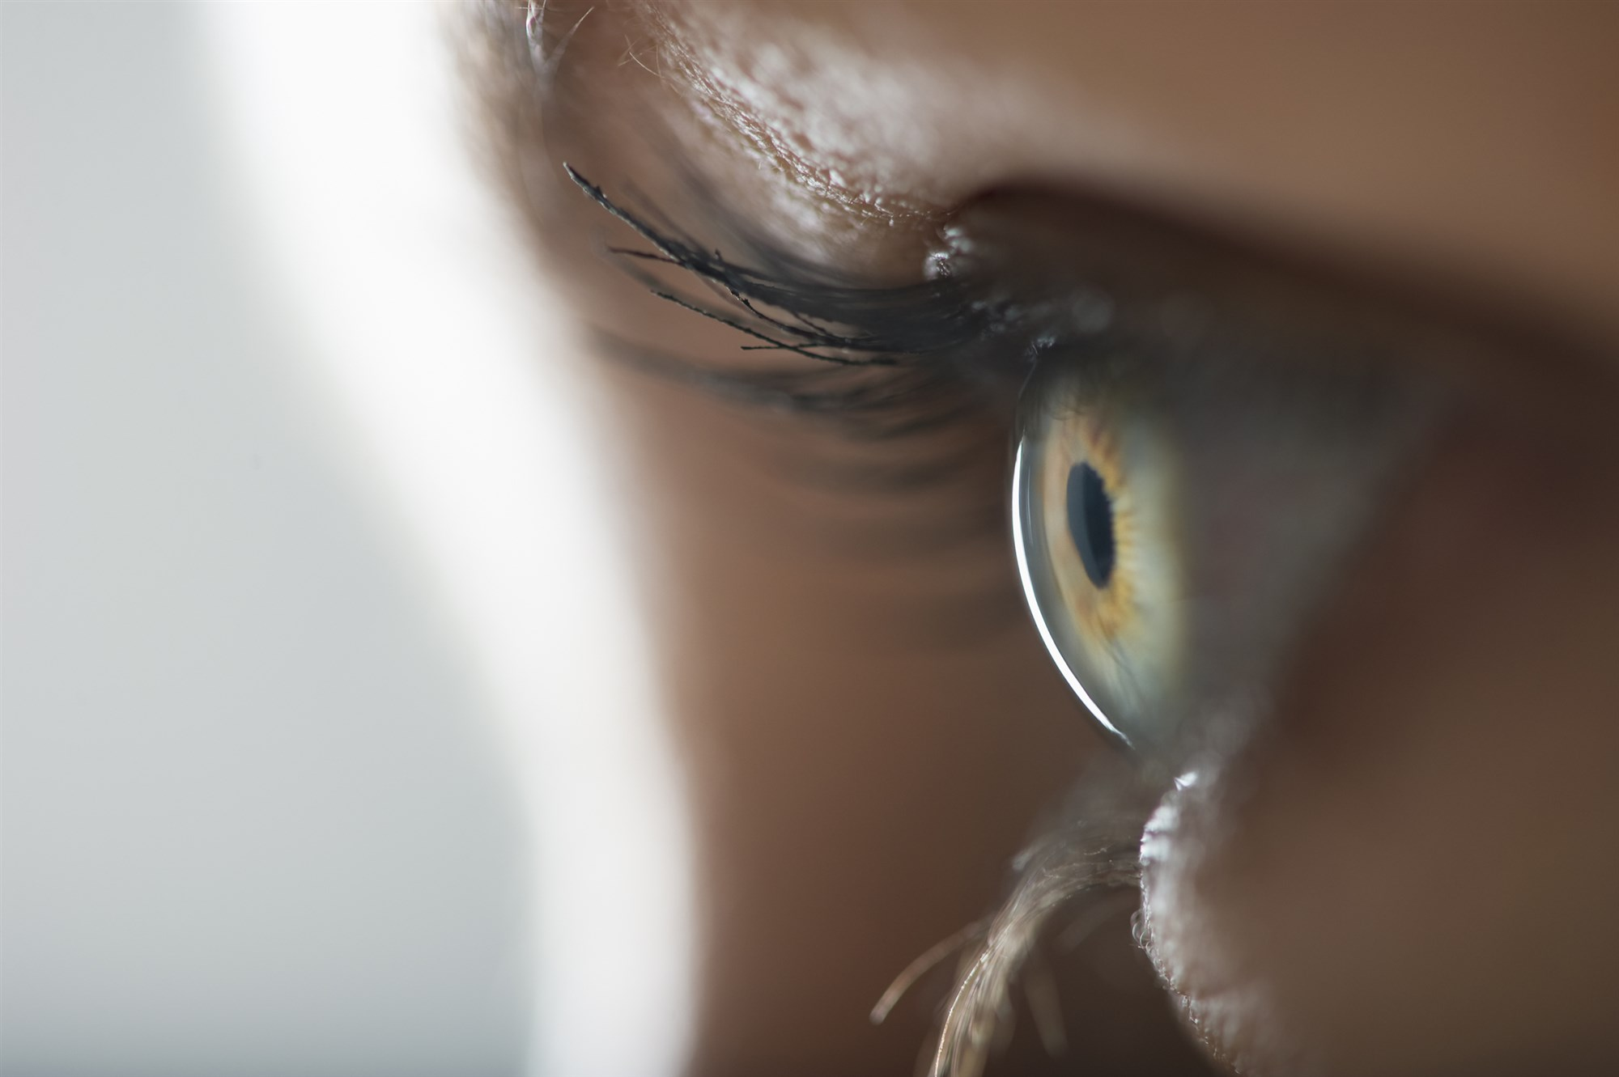
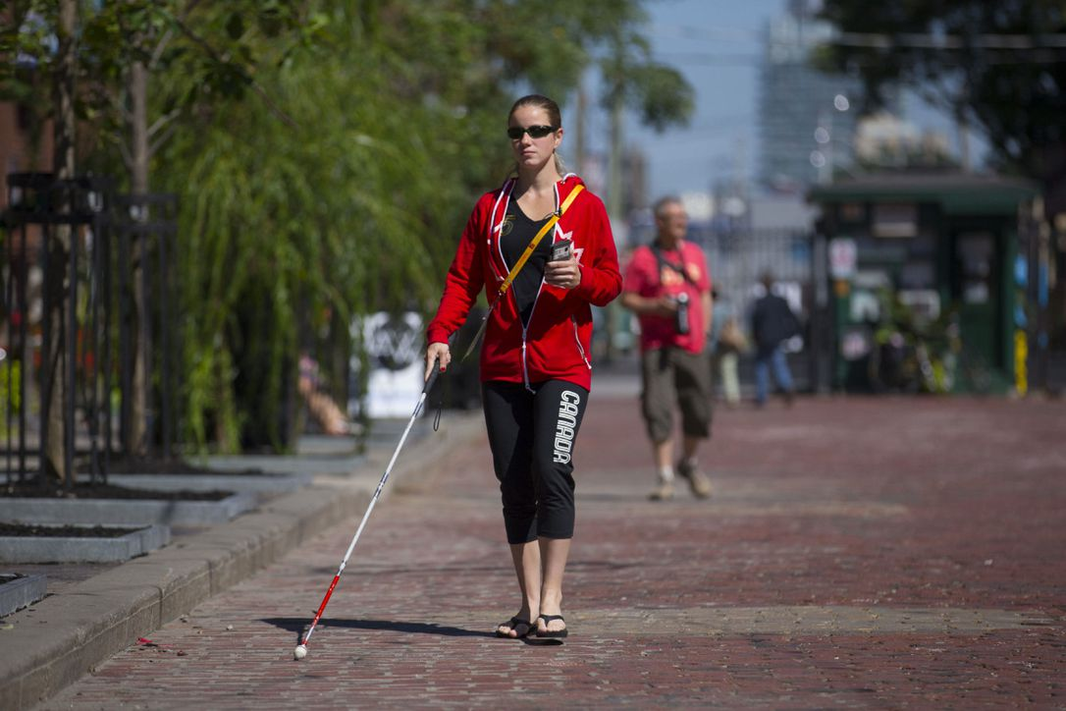
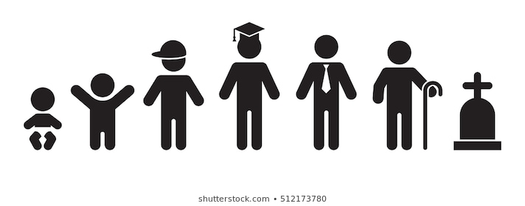
From idea to a product in few months
PROJECT NAME
MEHMET EMRE AYAR BUSRA YAYLAOGLU EMRE EREN, COMPUTER/BIOMEDICAL ENGINEERING, MEDIPOL UNIVERSITY
DISEASE DEFINITION & FACTS
Blindness can occur due to several causes. Common chronic eye diseases that can lead to blindness are diabetic and hypertensive retinopathy, cataracts, AMD, thyroid ophthalmopathy, glaucoma and dry eye.
There are 285 million people which are blind, 39 million complete, 246 million partial.
When the outcome is inevitable, one must include some compulsory changes in his/her life routine. There are lots of services and devices aim to make life easier for blind people which are provided by the local governments or the volunteers. Unfortunately, despite the large number of blind people, the World still can not provide sufficient life terms for the blind.
Blindness refers to the limitations in eyesight, lack of vision. It can be partial, means limited vision, or complete, total loss of vision. The term blindness is mostly used to describe complete blindness.
Blindness is mostly the final and the worst possible outcome of the mentioned diseases and can be avoided by proper treatments. It is crucial to not hinder the vision care and include it to healthcare routine.
PATIENT TIMELINE
Genetic mutations, infections, blocked tear ducts, strabismus, amblyopia, congenital glaucoma, retinopathy of prematurity (ROP) are common causes of infant blindness.
Blindness in teenagers and adults are mostly caused by an injury. However, despite the low percentages, common reasons such as glaucoma, macular degeneration and cataracts are still valid for these ages.
Age-related macular degeneration, glaucoma, cataract and diabetic retinopathy are the most common causes of vision loss among the elders.

Slide 2
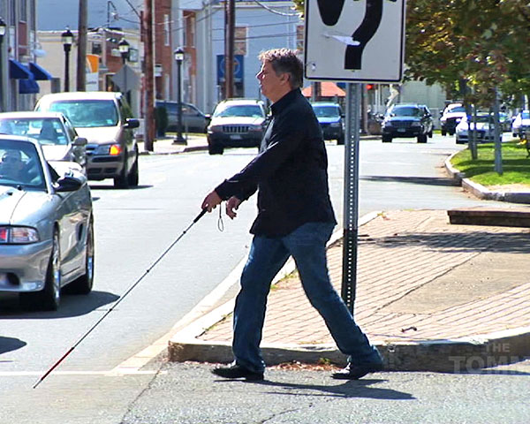
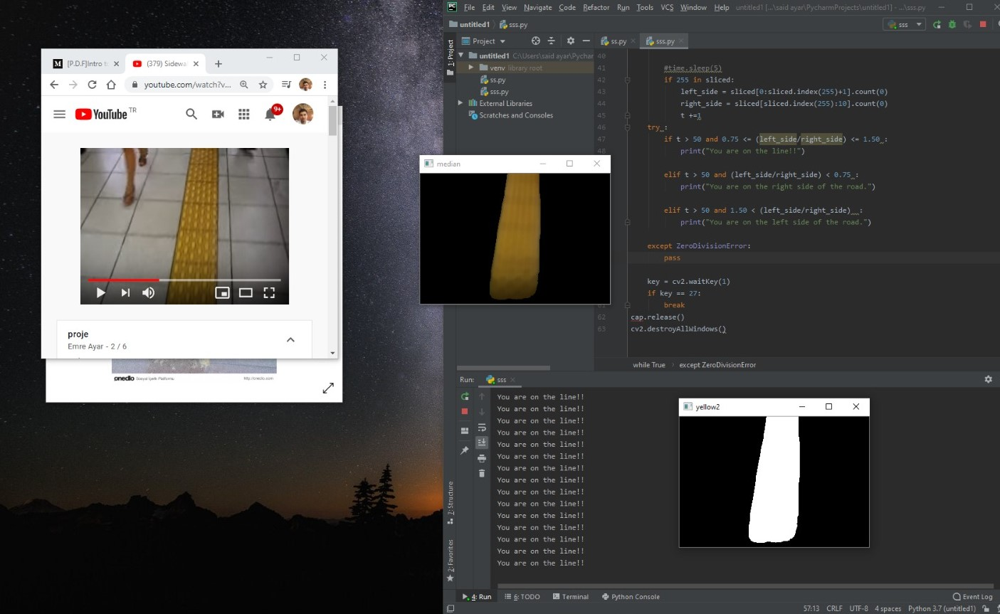


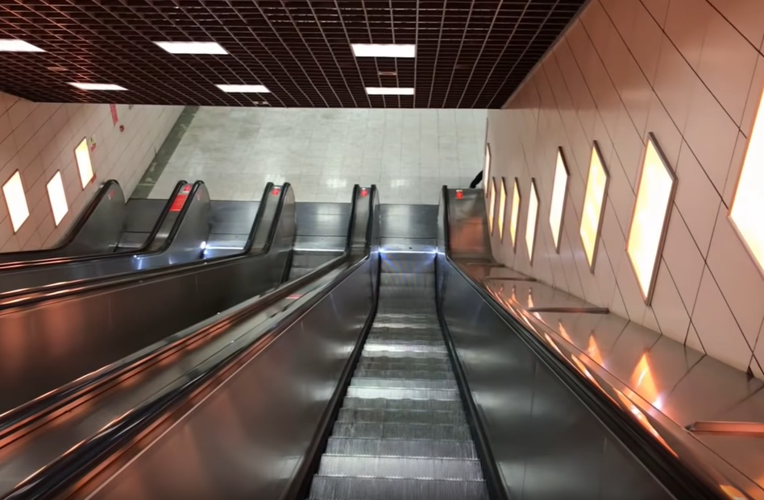
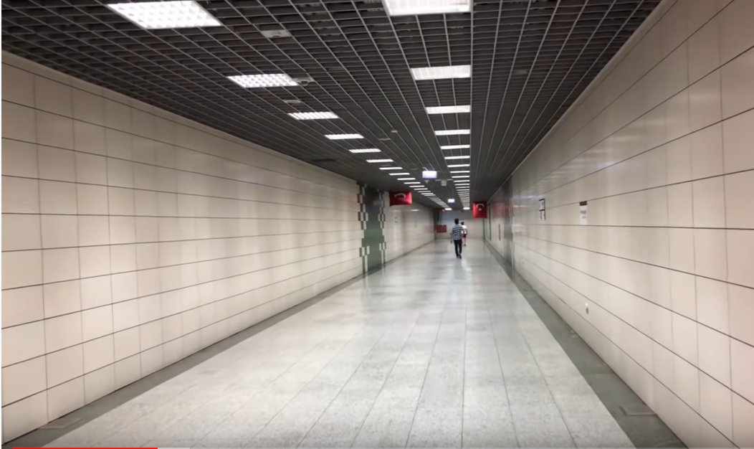
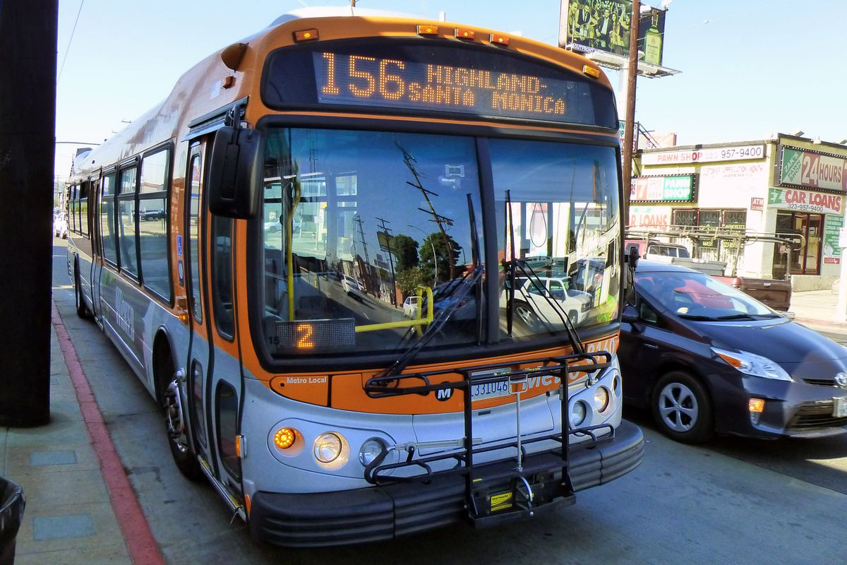
PROJECT NAME
TEAM MEMBERS, DEPARTMENTS, UNIVERSITY NAME
From idea to a product in few months
PROJECT NAME
MEHMET EMRE AYAR BUSRA YAYLAOGLU EMRE EREN, COMPUTER/BIOMEDICAL ENGINEERING, MEDIPOL UNIVERSITY
PROJECT DETAILS
The real problem for the blind starts when they decide to go out. They can rearrange their homes for themselves, but outside is a mystery for them.
There are some services for the blind like guide dogs, blind canes, or the main concept of this project, tactile paving.
BETA VERSION OF THE PROGRAM
The glasses that we had designed is programmed to detect the tactile paving on the sight. Glasses have one camera and one microphone. Camera will search for the tactile paving, detecting its unique color and pattern, and inform its user with the microphone. When the user is on the tactile paving, glasses will work as a lane tracking system, informs the user if he/she is getting out of the path, and guides he/she back to path.
Besides the tactile paving detection, in the further research, it was aimed to make more additions.

